Slide 1

Animal recognition
Image-audio recogntion & retrieval for pictures and sounds of animals
DIGITAL SIGNAL & IMAGE PROCESSING
2020-2021
Federico Luzzi - 816753
Federico De Servi - 812166

Slide 2
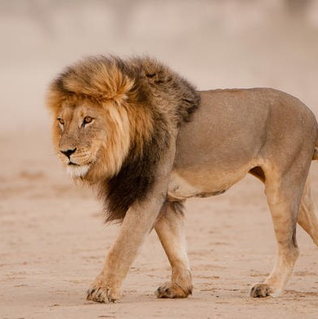
Topics
1) AUDIO RECOGNITION
2) IMAGE RECOGNITION
3) IMAGE RETRIEVAL
4) DEMO

Slide 3
AUDIO RECOGNITION

Slide 4

Objective
We wanted to train a CNN model in order to classify correctly the biggest number of audio containing sounds of animals. These sounds have a lenght that ranges from 2 to 3.5 seconds and different levels of background noise.

Slide 5
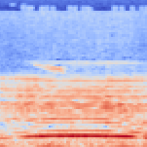
Preprocessing
First of all we applied the Resnet preprocessing function. Then, after applying data augmentation to the audios (pitch shift, gaussian noise, normalization), we created a mel-spectrogram from each audio. We also applied a Frequency Mask to some of the mel-spectrograms. This audio classification problem became then a classical image classification one, thus giving us the opportunity to even use pre-trained models like ResNet.

Slide 6
Modelling
ResNet101
Dropout(0.5)
ReLU()
BatchNormalization()
Dense(200, activation='relu', kernel_regularizer=regularizers.l2(l2=0.0005))
Dropout(0.5)
ReLU()
BatchNormalization()
Dense(10, activation='softmax')
First of all, since we face an umbalanced problem, we calculated the weights for each of the 10 classes, using them during training. We tried various models, ranging from simple models made by ourselves to complex image recognition models.
After many trials, this model resulted to be the best. It uses ResNet101 with imagenet weights, followed by a block made of Dropout + ReLu activation function + BatchNormalization layer. We then added a Dense layer with 200 units and l2 weight regularization and another block of Dropout + ReLu activation function + BatchNormalization layer. We then added a Dense layer with 10 units and softmax activation function as final layer.
+
+
+
+
+
+
+
+

Slide 7
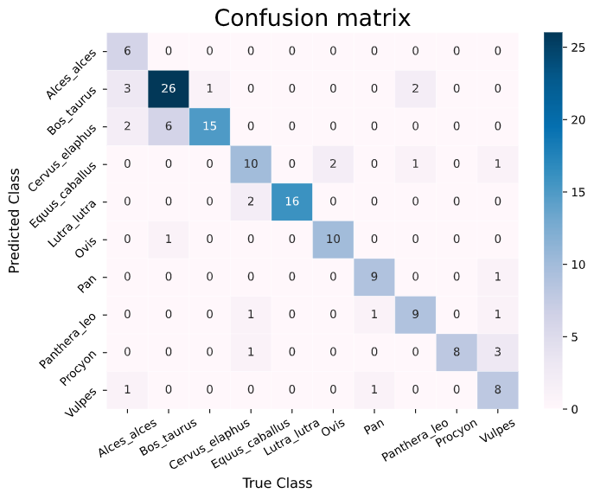
Results

Slide 8
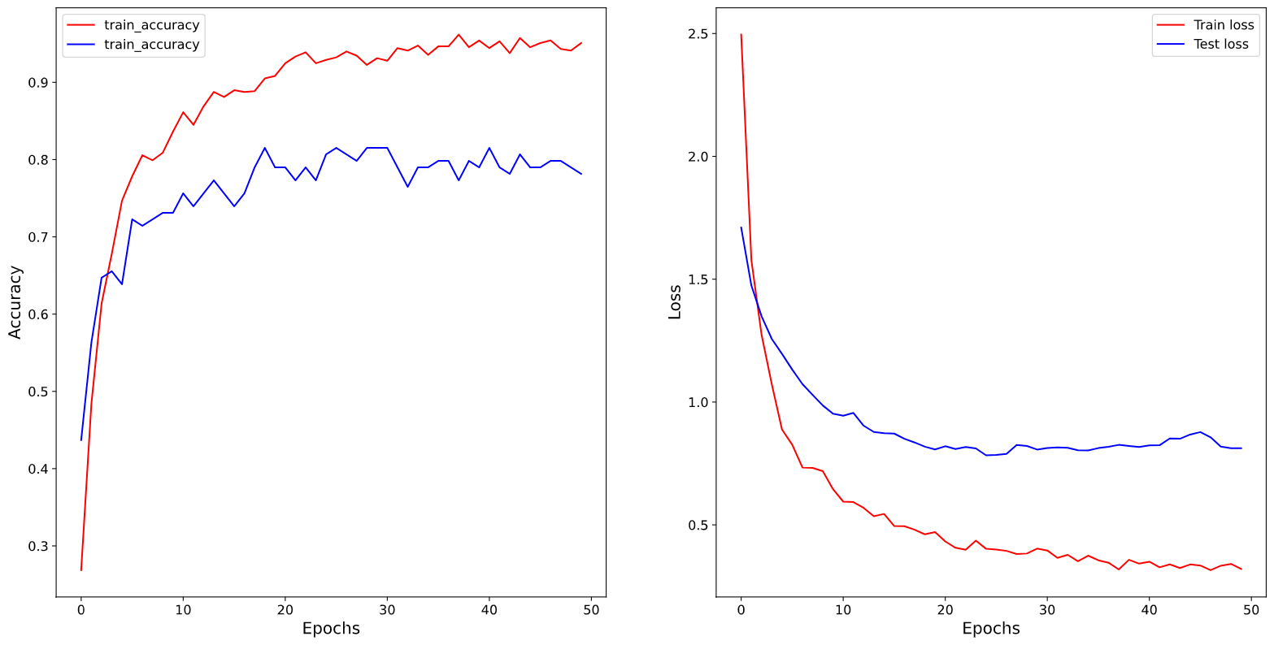
Results

Slide 9
image RECOGNITION

Slide 10
Objective
This time we wanted to perform a classic image classification problem. After applying some data augmentation techniques to our images (ImagesWithAttributes2 ), we tried transfer learning with different pretrained models.

Slide 11
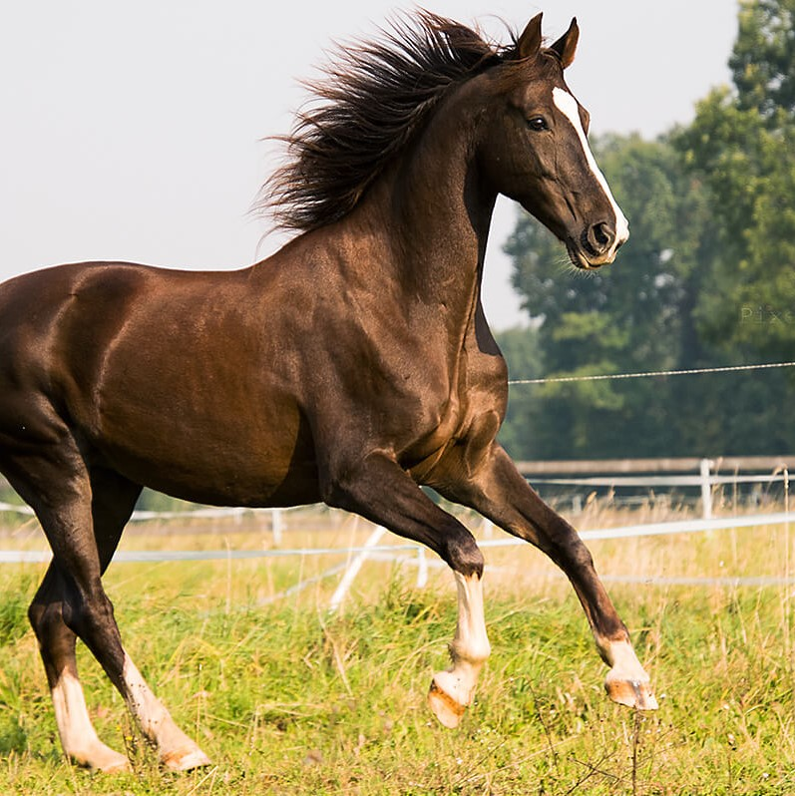
Preprocessing
First of all we applied the Resnet preprocessing function. After doing that, we applied data augmentation techniques, like zooming, flipping horizontally, rotating, shifting and changing the brightness of the images. We then imported them all as 224x224x3 rgb images and fed them to our model.

Slide 12
Modelling
ResNet101
BatchNormalization()
Dense(50, activation='relu', kernel_regularizer=regularizers.l2(l2=0.0005))
BatchNormalization()
Dense(10, activation='softmax')
Since we face an umbalanced problem as before, we calculated the weights for each of the 10 classes, using them during training. The obvious choice here was to use transfer learning from previously trained models on imagenet.
After many trials, this model resulted to be the best. It uses ResNet101 with imagenet weights, followed by a BatchNormalization layer. We then added a Dense layer with 50 units and l2 weight regularization and another BatchNormalization layer. We then added a Dense layer with 10 units and softmax activation function as final layer.
+
+
+
+

Slide 13
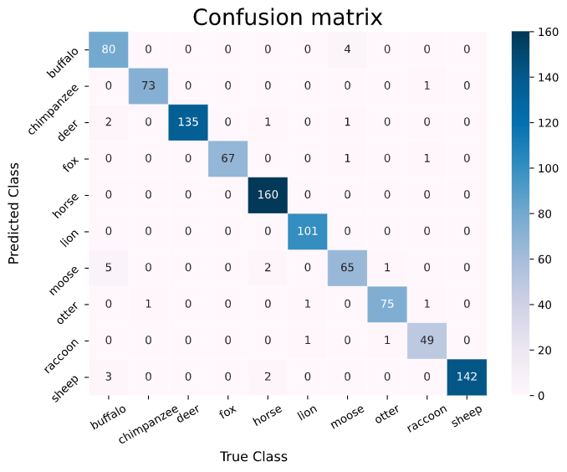
Results

Slide 14
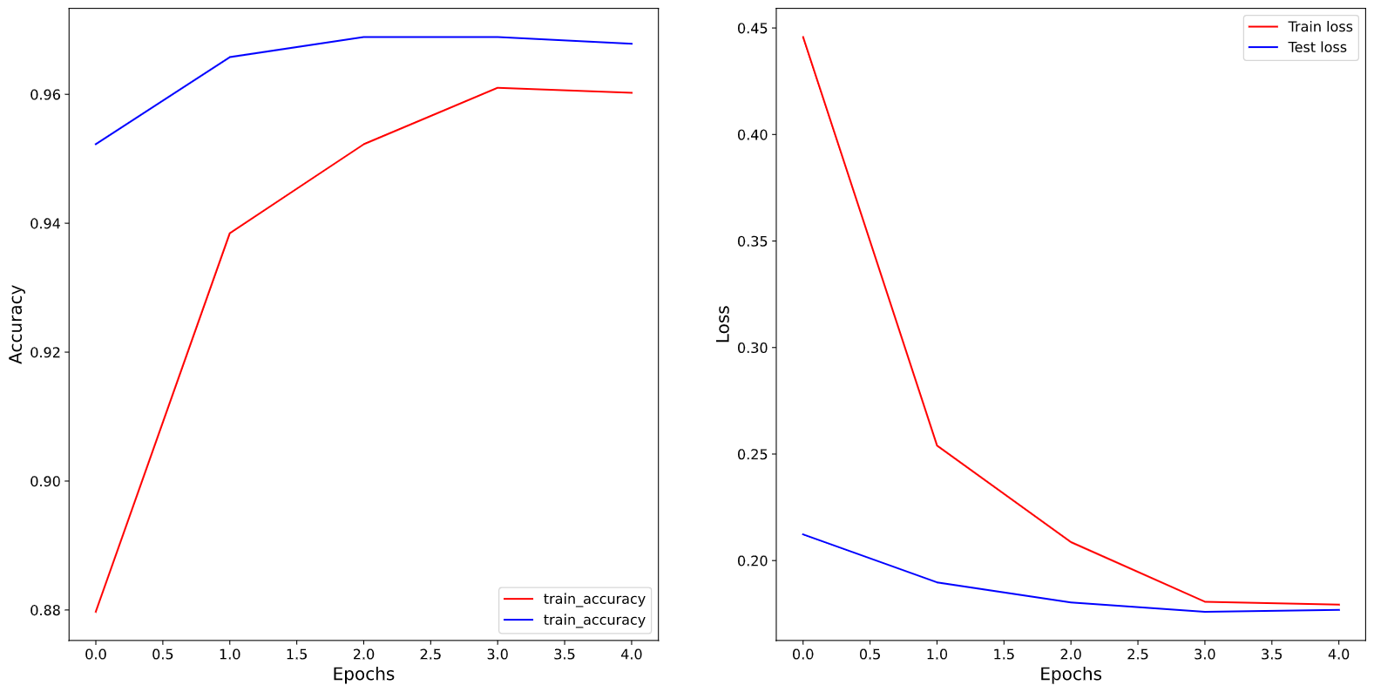
Results

Slide 15
Image retrieval

Slide 16
Objective
The goal of the Image Retrival task is to select the 9 most similar animal images based on a query one. In particular This tool would perform on real animals images and picture ones.

Slide 17
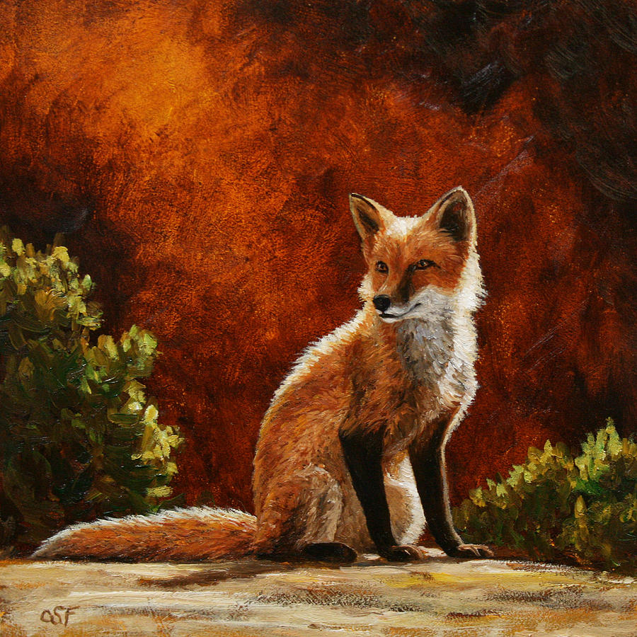
Preprocessing
The neural network wants an input image of 224x224 pixels with 3 color channels (RGB). So the query image would be resized to fit in.
Also resnet preprocess function is applyed.

Slide 18
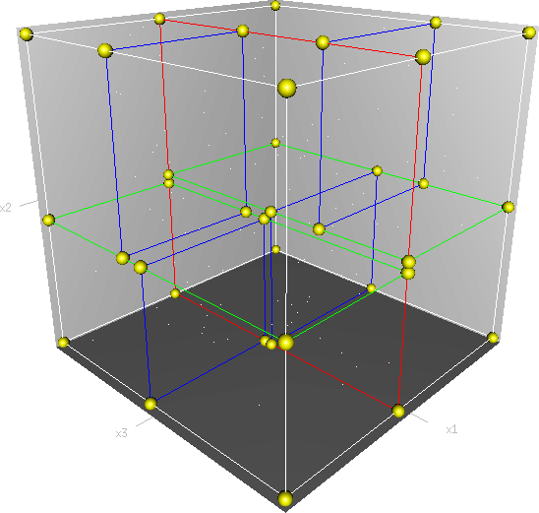
Modelling
ResNet101
Feature Extraction
KDTree
Different popular neural networks have been tried to generate the feature space: mobilenet_v2, inceptionV3, …
The best model tried is ResNet101, the whole model is used except the feedforward part.
Each instance have 2048 features.
In order to get a fast response on the features space a KDTree structure is implemented.

Slide 19
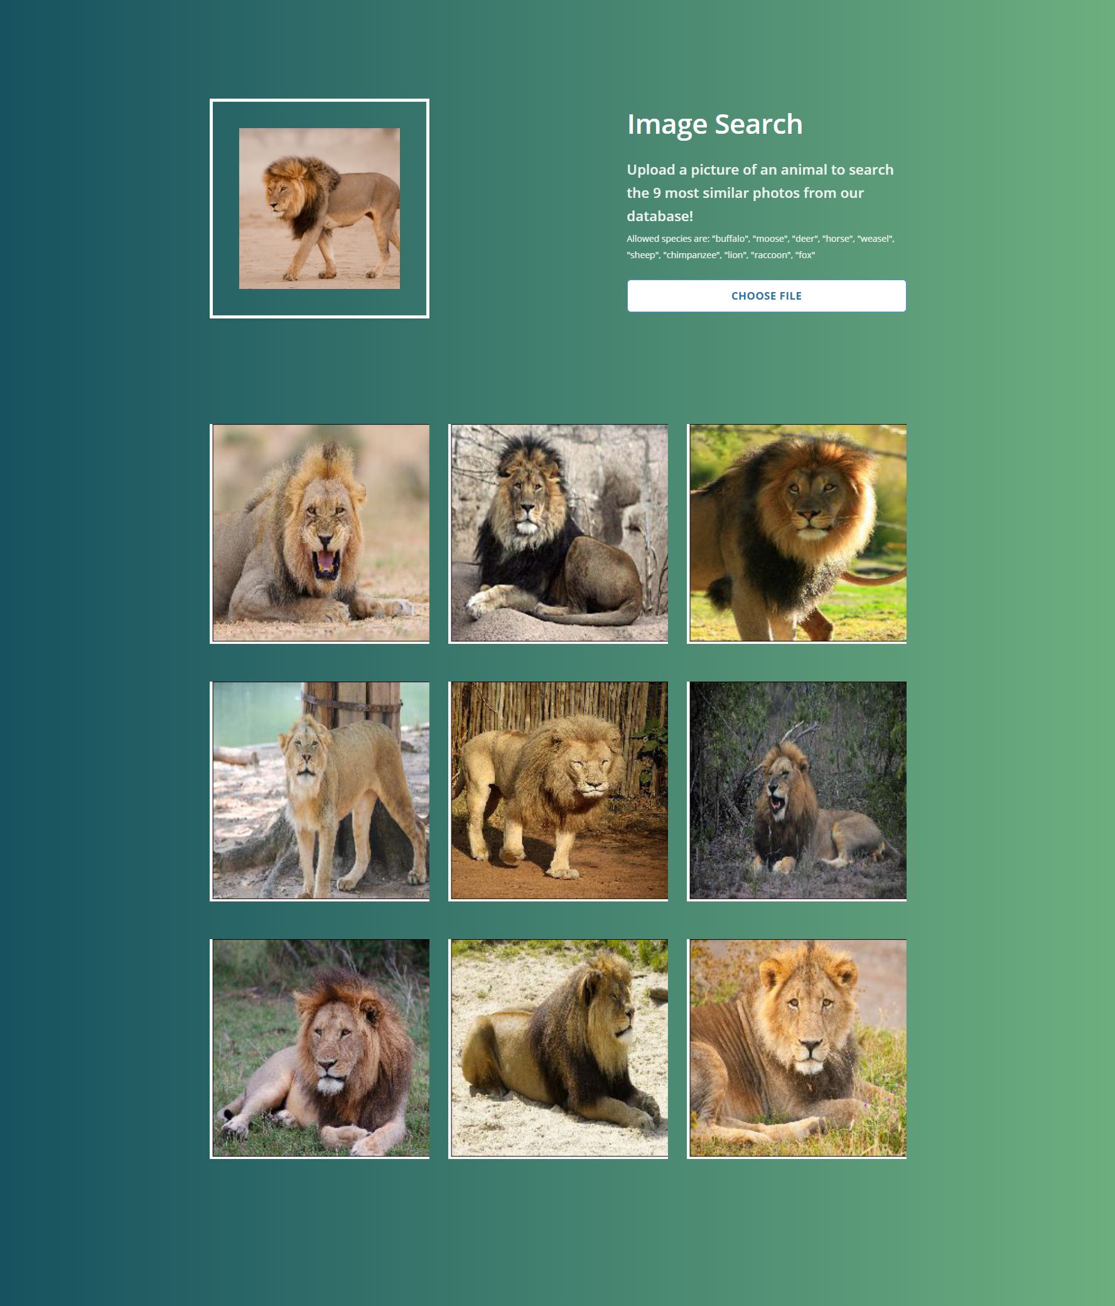
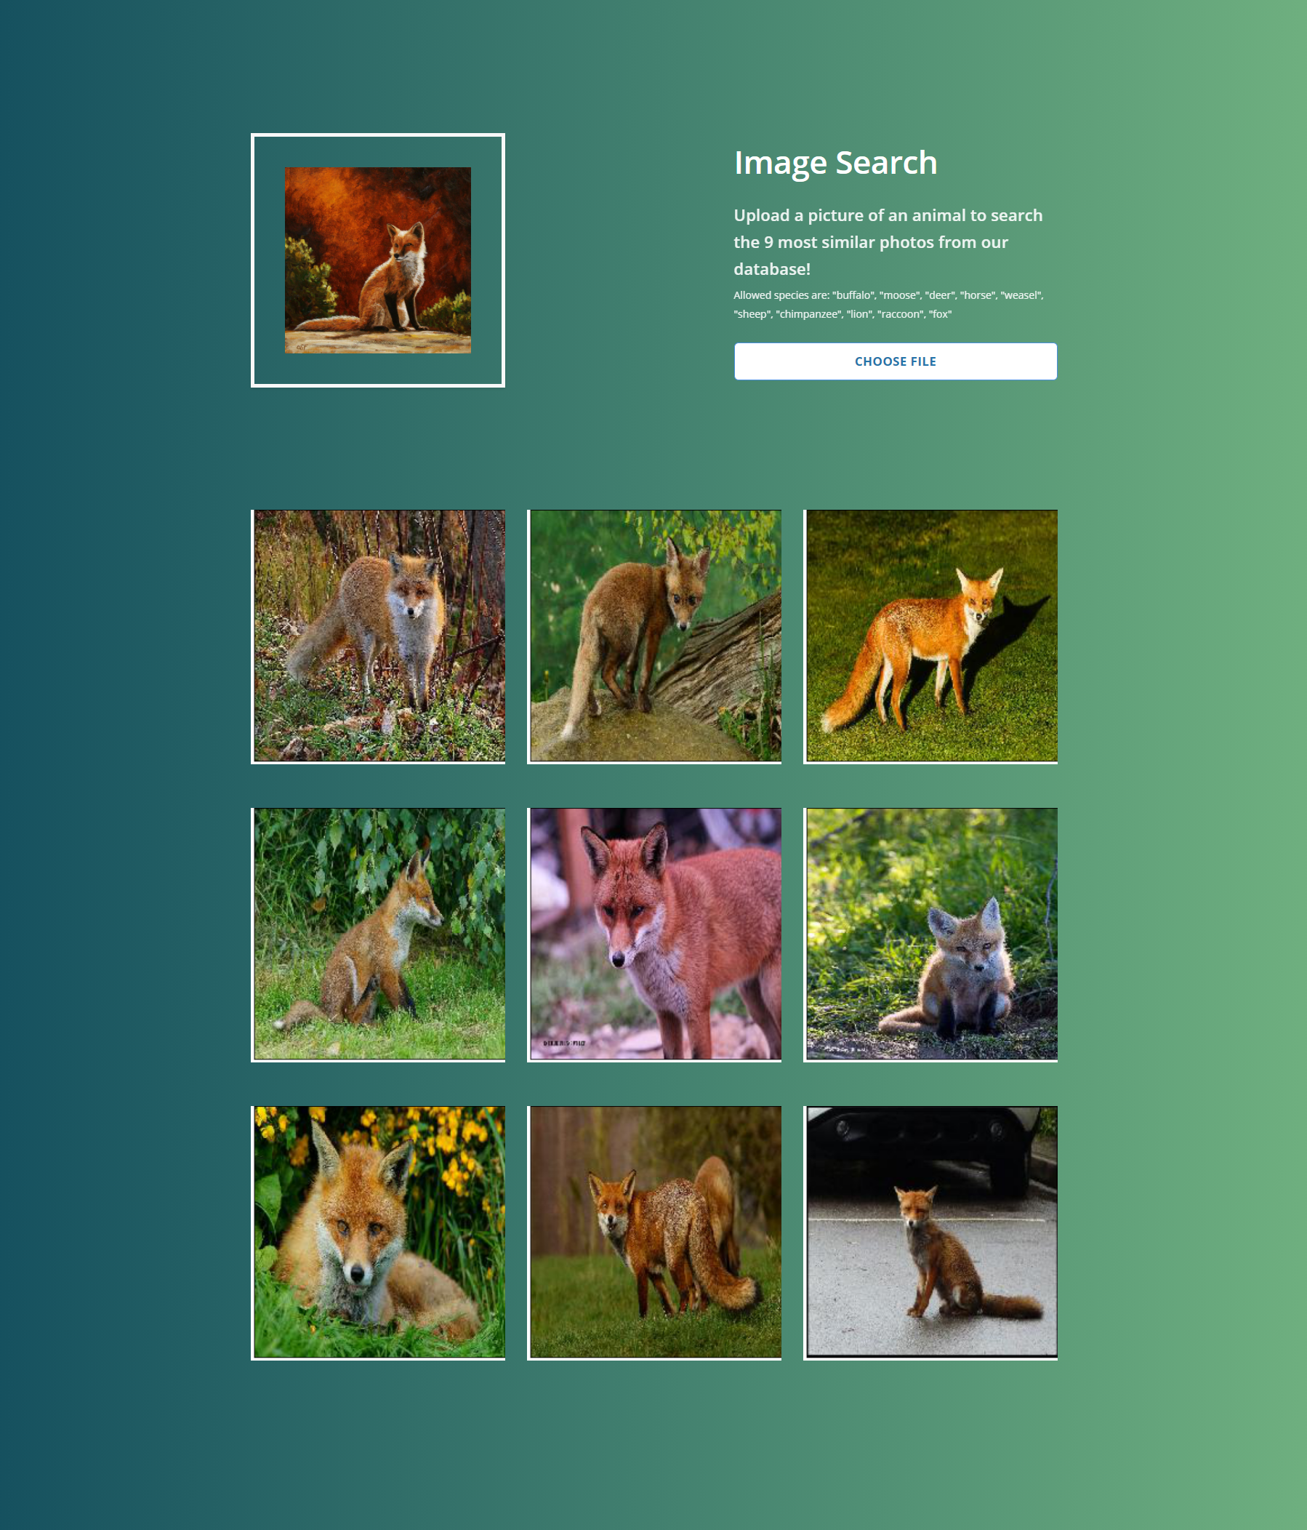
Results

Slide 20
Demo

Slide 21
Demo

Slide 22
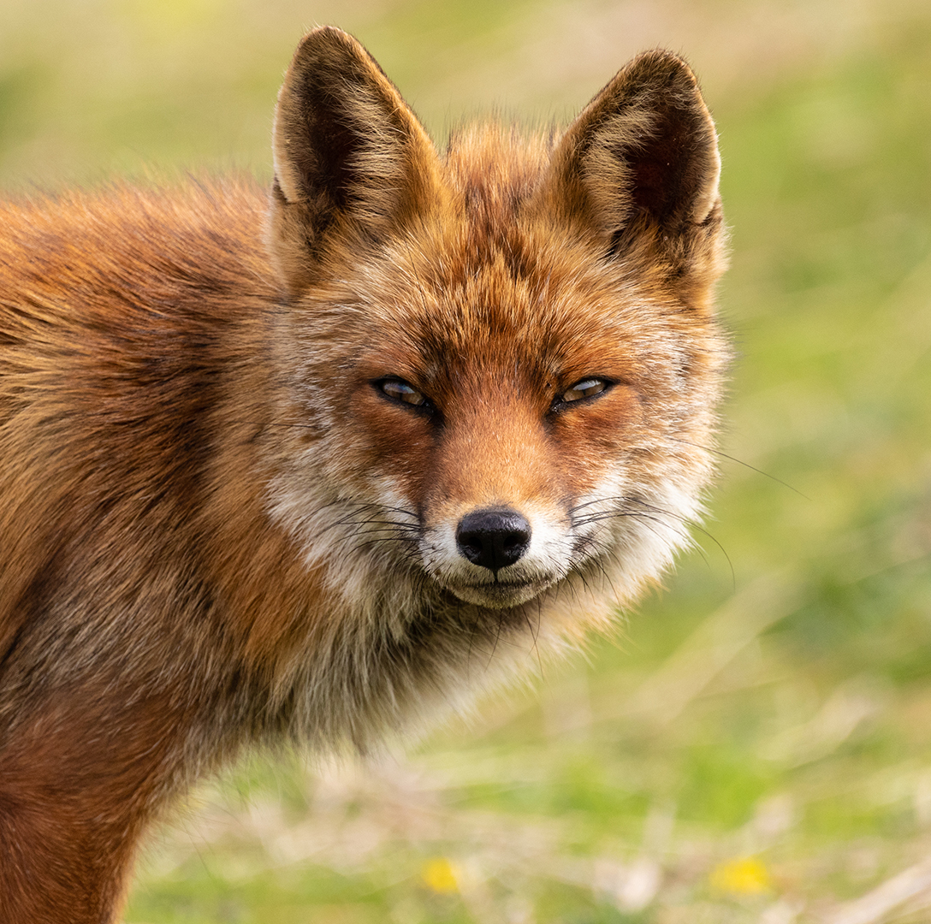
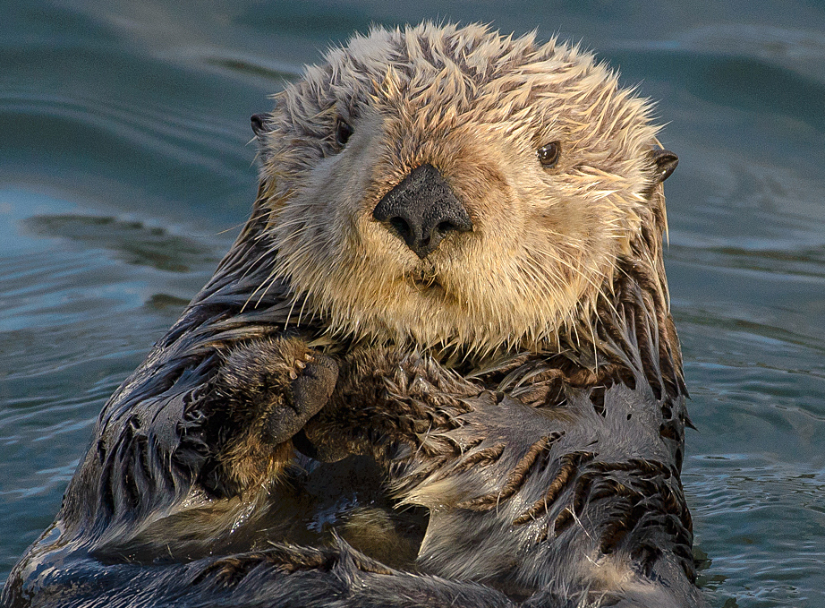
Grazie
Federico Luzzi - 816753
Federico De Servi - 812166

